Slide 1


Customer Churn EDA

Slide 2
Problem Overview
Understanding the reasons behind customer churn is crucial to developing effective retention strategies.
The telecom company is facing a high rate of customer churn, resulting in significant revenue loss.

Slide 3
Imoprtance of Customer Churn Study
Retaining customers is more cost-effective than acquiring new customers.
Insights gained from the analysis will guide targeted retention efforts and improve customer satisfaction.

Slide 4

1
Identify factors that lead to customer churn.
Analysis Goals
2
Analyze patterns and correlations in the data.
3
Provide actionable recommendations to reduce customer churn.

Slide 5

Total Customers
440.8 K
Churners
Not Churners
250 K
190.8 K

Slide 6

Total Not Churners Spend
Total Churners Spend
$ 143 M
$ 145 M

Slide 7
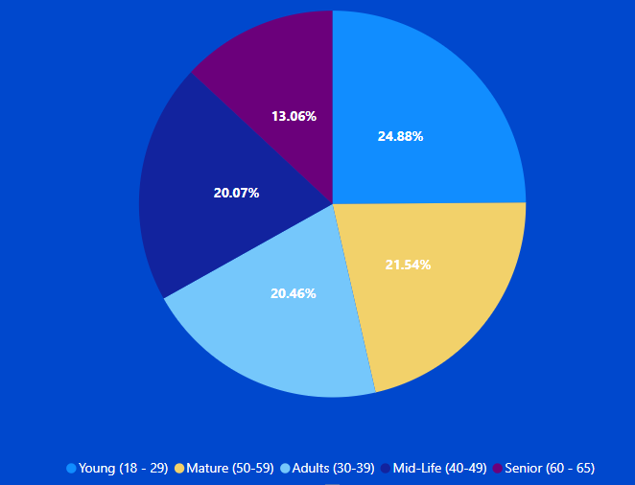
Age
As you can see most of the Curners in the Young (18-29) group

Slide 8
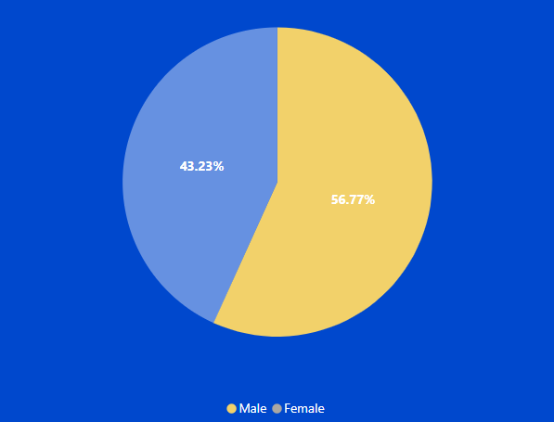
Gender
Customers Gender
Most of customers are Male

Slide 9
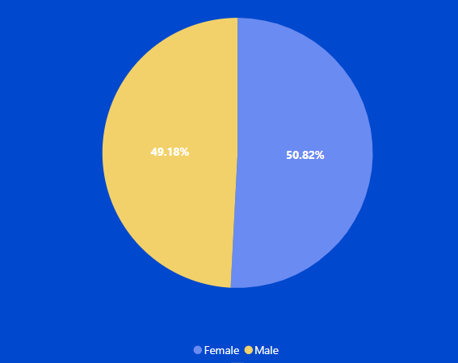
Gender
Churners Gender
Most of customers are Male
The most of churners are females customers

Slide 10
Support Calls
3%
Avg. Customers Support Calls
The percentage of churners increases as the number of calls increases.
3

Slide 11
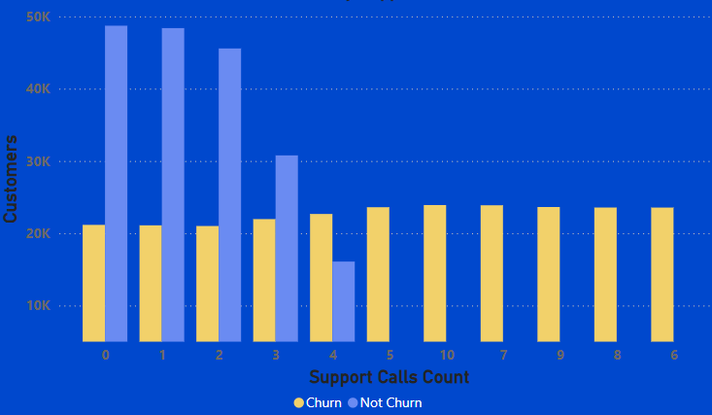
Support Calls
3%
Churners By Support Calls
There is an inverse relationship between customers who experience churn and customers who contact customer service. The more times the customer contacts, the more likely they are to experience churn.

Slide 12
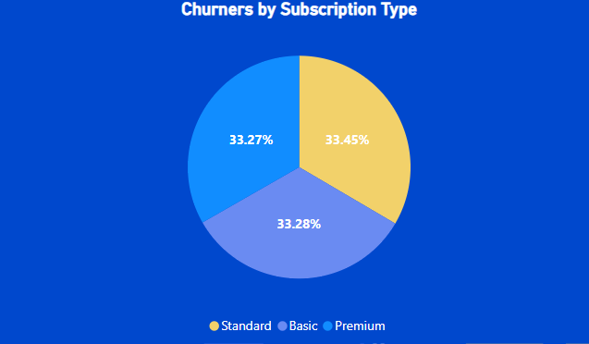
Subscribtion Type
The percentages are very close, but in theory the standard subscription type customers are the most churn out.

Slide 13
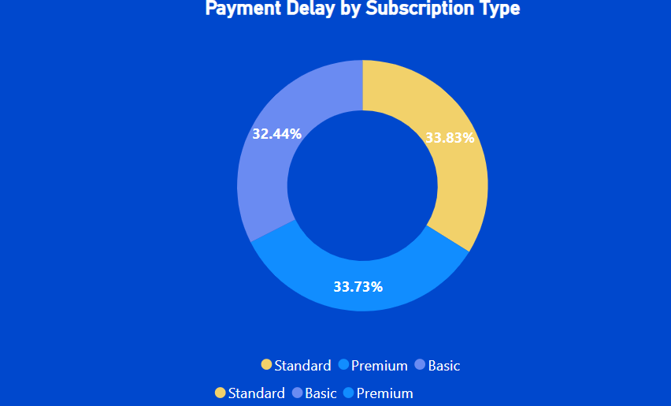
Subscribtion Type
Customers with standard subscription have the highest payment delay.

Slide 14
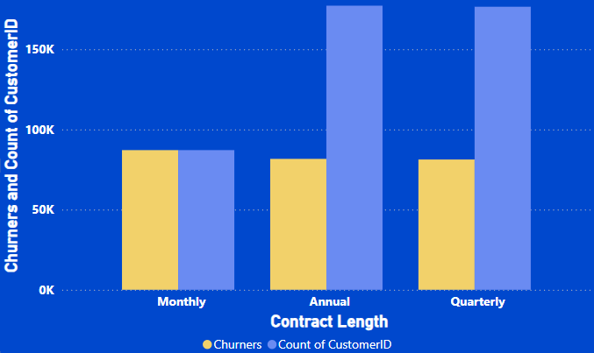
Contract Length
Almost half of customers with annual and quarterly contracts churn, but customers with monthly contracts all churn

Slide 15






What We Found
Age
Gender
Support Calls
Contract Length
Subscribtion Type

Slide 16


1
Young (18-29)
Comming Churner
2
Female
3
Customers who use support more than 3 times have a higher percentage of churn

Slide 17

4
Standard Subscription
Comming Churner
5
Monthly Contract length

Slide 18

Recommendaions

Slide 19

What We Can Do To Prevent Customers to Churn out
Help and Improve the service for who make support calls more than 2 calls
1
Pay attention and improve the monthly contract
2
Improve the standard type of subscription
3

Slide 20

What We Can Do To Prevent Customers to Churn out
Pay More Attension by offering special packages for Young People (18-29)
4
Make Vouchers and Offers for Female churners to decrease the female churn rate and total spending of them
5
Make Vouchers and Offers for Female Churner To decrease the female churn rate and total spend of them
6

Slide 21
Thanks

